Slide 1

FINAL YEAR RESEARCH PROJECT
End-term Presentation
[Al-Based Phishing Website Detection using Hybrid Feature Learning]
Supervised By: Mr. Subhasish Mohanty
Group No.: 26-10
Piyush Kumar Pradhan(2241016408)
Raja Kishor Nayak(2241014110)
Tanmaya Mangaraj(2241013095)
Aditya Pal(2241016031)
S Ramananda Sagar(2241019007)
Department of Computer Sc. and Engineering
Faculty of Engineering & Technology (ITER)
Siksha ‘O’ Anusandhan (Deemed to be) University
Bhubaneswar, Odisha
1

Slide 2
Presentation Outline
Problem Statement & Motivations
Problem Statement
Motivations
Literature Review
Existing Solutions & Limitations
Proposed Methodology & Approach
Key Components/Modules & Algorithms Used
Dataset(s) & Tools/Technologies
Experimentation
System Specification
Experimental Results
Performance Analysis
Conclusion and Future Scope
References
2

Slide 3
Problem Statement
Phishing attacks are rapidly increasing and becoming a major cybersecurity threat.
Attackers create fake websites to steal sensitive user data like passwords and banking details.
The main issue is that users often cannot distinguish between legitimate and fraudulent websites.
This problem is critical as it leads to financial loss and data breaches for individuals and organizations.
Therefore, there is a need to develop an intelligent, machine learning-based system for accurate and phishing detection.
3

Slide 4
Motivations
Growing phishing and cybercrime attacks globally.
Automated detection systems are required.
Conventional blacklist techniques don't work.
Aids financial systems, organizations, and users.
Hybrid feature learning improves detection accuracy and efficiency.
Enhances overall cybersecurity using Artificial Intelligence and Machine Learning techniques.
4

Slide 5
Literature Review
Table 1:Summary of Existing Approaches and Research Limitations
S. No. | Author & Year | Methods/Techniques Used | Dataset Used | Research Outcomes | Findings
1 | Nusrath Tabassum, et al. (2021) | Hybrid ensemble combining SVM, Decision Tree, Random Forest, and XGBoost using bagging and boosting concepts; feature ranking via RF and XGBoost. | Collected from UCI machine learning repository (11,055 URLs: 4,898 legitimate, 6,157 phishing). | Accuracy : 98.28% F1 score : 0.98% AUC : 0.92 Recall : 0.98% | CNNs are better at recognizing complex features in malicious URLs. DL models provide enhanced classification precision and adaptability over traditional and baseline ML models.
2 | Sumitra Das Guptta, et al. (2022) | Hybrid feature-based strategy using URL and client-side hyperlink features; classification via XGBoost, RF, DT, and SVM. | Developed a new dataset of 6,000 URLs (3,000 phishing from PhishTank, 3,000 legitimate from Alexa/UNB). | Accuracy : 99.17% F1 score : 0.99% AUC : 0.9989 Recall : 98.81% | Combining interpretable feature reduction (RSTHFS) with residual deep learning yields robustness, scalability, and transparency for real-world cybersecurity deployments.
5

Slide 6
Literature Review
Table 2:Summary of Existing Approaches and Research Limitations
S. No. | Author & Year | Methods/Techniques Used | Dataset Used | Research Outcomes | Findings
3 | Mukta Mithra Raj and J. Angel Arul Jothi (2022) (Base Paper) | Eight baseline machine learning classifiers (XGBoost, RF, AdaBoost, DT, KNN, SVM, LR, NB) and developed hybrid models utilizing a voting classifier. | A Kaggle phishing websites dataset encompassing over 11,000 URLs with 30 specific attributes. | Accuracy :92.07%. F1 score : 90.2% AUC : Not reported Recall : Not reported | Feature selection did not actually enhance classification performance. The efficiency of the classifiers decreased substantially as the number of attributes was reduced, indicating that when a dataset is noise-free.
4 | Rekha Pal, et al. (2023) | Applied multi-stage feature selection and used optimized features in various ML models to compare and evaluate overall classification performance. | The UCI Phishing Guide Classification dataset containing 11,054 URLs (55.69% legitimate and 44.31% phishing). | Accuracy : 97.48% F1 score : Not reported AUC : 100 Recall : Not reported | Logit (LR) model selected 25 key features, reducing overfitting risk. RF achieved the highest performance among all classifiers.
6

Slide 7
Literature Review
Table 3:Summary of Existing Approaches and Research Limitations
S. No. | Author & Year | Methods/Techniques Used | Dataset Used | Research Outcomes | Findings
5 | Kavya S & Sumathi D (2024) | Stacking ensemble framework utilizing LSTM, CNN, Random Forest, and Genetic Algorithms (GA) for feature selection. | Over 30,000 samples (balanced benign/phishing) supplemented by WHOIS, SSL, and DNS data. | Accuracy :97.1%. F1 score : 96.4%. AUC : 0.97 Recall : 96.5% | Combining temporal (LSTM), visual (CNN), and structured data (RF) captures diverse and complex phishing patterns frequently missed by single models.
6 | Rangaswamy K, et al. (Jan 2025) | Decision Trees, Random Forests (baseline); Gated Recurrent Units (GRU), Convolutional Neural Networks (CNN). Included URL normalization and tokenization. | Phishing Site URLs from Kaggle (549,000 entries) and a refined feature subset (11,430 records). | Accuracy : 98.00% F1 score : 97.00% AUC : Not reported Recall : 96.00% | CNNs outperformed GRUs by effectively capturing spatial and sequential URL patterns, proving to be a robust and scalable automated detection system.
7

Slide 8
Literature Review
Table 4:Summary of Existing Approaches and Research Limitations
S. No. | Author & Year | Methods/Techniques Used | Dataset Used | Research Outcomes | Findings
7 | K. Pavan Sankar & P. Bhaskar Naidu (May 2025) | Hybrid LSD model (Logistic Regression, SVM, Decision Tree) with voting schemes; 1D Convolutional Neural Network (CNN). | Phish Tank, UNB, and Alexa datasets (200,000 phishing and 200,000 legitimate URLs). | Accuracy :99.70%. F1 score : 95.91%. AUC : Not reported Recall : 96.00% | The hybrid ensemble and 1D CNN frameworks significantly surpassed traditional standalone classifiers, serving as highly effective tools against deceptive URLs.
8 | Ashvini Jadhav & Pankaj Chandre (Oct 2025) | Hybrid machine learning combined with heuristic rule-based frameworks; Variance thresholding, RFE, Random Forest, XGBoost, and CatBoost. | Five diverse datasets including UCI URL, Mendeley, and PhiUSIIL (combining URLs, HTML features, and email headers). | Accuracy : 95.80% F1 score : Not reported AUC : Not reported Recall : Not reported | Combining heuristic-guided feature selection with hybrid data integration greatly improves scalability, stability, and policy-compliant detection across multiple domains.
8

Slide 9
Literature Review
Table 5:Summary of Existing Approaches and Research Limitations
S. No. | Author & Year | Methods/Techniques Used | Dataset Used | Research Outcomes | Findings
9 | Wakchaure Sanchit Sanjay, et al. (Nov 2025) | Rough Set Theory-Based Hybrid Feature Selection (RSTHFS) combined with a deep Residual Multi-Layer Perceptron (ResMLP). | Open-source datasets drawn from Kaggle, UCI, and Mendeley (120,000 total URLs). | Accuracy :98.29%. F1 score : 98.20%. AUC : 0.98 Recall : 97.90% | The RSTHFS+ResMLP pipeline successfully cut the necessary feature space by ~69% and training time by 61%, maintaining top-tier accuracy alongside high explainability.
10 | Raheleh Ghadami & Javad Rahebi (Dec 2025) | GAN + DPCA for data augmentation; CNN-GRU-FMRCNN for feature extraction; BKA, ANOVA, and Spearman for selection; SVM for classification. | PhishTank (augmented to a 10k/10k balanced set) and ISCX-URL-2016 datasets. | Accuracy : 99.53% F1 score : Not reported AUC : 0.95 Recall : 98.37% | Integrating GAN augmentation with spatial-temporal feature extraction (FMRCNN) effectively resolves class imbalance and heavily improves the detection of complex zero-day attacks.
9

Slide 10
Literature Review
Table 6:Summary of Existing Approaches and Research Limitations
S. No. | Author & Year | Methods/Techniques Used | Dataset Used | Research Outcomes | Findings
11 | A. Sravanthi, A. Anjum Kousar, Anushka R Dabole, Grietje Junita G, and Dr. S Elango (April 2026) | A Hybrid approach integrating feature-based Random Forest (Machine Learning) with sequence-based Long Short-Term Memory (LSTM) (Deep Learning) models. | Publicly available datasets from UCI Machine Learning Repository, Kaggle, and real-time phishing URLs from PhishTank . | Accuracy :98.29%. F1 score : 98.20%. AUC : 0.98 Recall : 97.90% . | The hybrid RF + LSTM model achieved 98.29% accuracy, 98.20% F1, 0.98 AUC, and 97.90% recall, delivering robust real-time phishing detection with improved interpretability
12 | Pratik Ahirwar and Prof. Anurag Shrivastava (April 2026) | Systematic review focusing on Deep Learning architectures including Convolutional Neural Networks (CNN), Recurrent Neural Networks (RNN), LSTMs, BERT, Graph Neural Networks (GNNs). | This paper does not explicitly mention a specific dataset used, as it is a systematic review paper — it reviews and analyzes existing research rather than conducting experiments on a dataset. | Accuracy : Not reported F1 score : Not reported AUC : Not reported Recall : Not reported | A. Sravanthi, A. A. Kousar, A. R. Dabole, G. J. G, and S. Elango, "Hybrid AI for phishing site detection," International Research Journal of Modernization in Engineering Technology and Science.
10

Slide 11
Literature Review
Limitations
Difficulty in detecting zero-day and evolving phishing attacks.
Heavy dependence on handcrafted and URL-based features.
High computational complexity and training requirements.
Limited real-time deployment capability.
Lack of Explainable AI (XAI) integration.
High false positive rates in practical environments.
Poor scalability in large-scale phishing detection system.
11

Slide 12
Research Gap & Improvements
Research Gap:
Inability to detect zero-day phishing attacks:
Existing systems fail to identify newly generated phishing URLs that are not present in blacklists or trained datasets.
High dependency on manual feature engineering:
Traditional machine learning models rely heavily on handcrafted URL features, reducing adaptability and automation.
Limited real-time performance and scalability:
Many phishing detection models are computationally expensive and unsuitable for large-scale real-time deployment.
12

Slide 13
Research Gap & Improvements
Research Gap:
Explainable AI (XAI) rarely integrated:
Most existing approaches lack transparency, making it difficult to understand how predictions are generated.
Ensemble learning underutilized :
Several studies focus only on single models instead of leveraging ensemble techniques for improved detection accuracy and robustness.
13

Slide 14
Research Gap & Improvements
Improvements:
Improved zero-day phishing attack detection using Ensemble Learning:
Combines multiple models to identify previously unseen phishing URLs more effectively.
Automated feature selection using Recursive Feature Elimination (RFE) :
Selects the most important features automatically to improve model performance.
Fast and scalable real-time phishing URL detection pipeline:
Designed an optimized system capable of handling real-time phishing detection efficiently.
14

Slide 15
Research Gap & Improvements
Improvements:
Integrated Explainable AI (SHAP) for transparent predictions:
Provides visual explanations to understand how the model makes predictions.
Enhanced accuracy and robustness using Stacking and Voting Ensembles :
Uses ensemble techniques to achieve higher prediction accuracy and reliability.
15

Slide 16
Proposed Methodology & Approach
Data Collection:
Multi-dataset phishing dataset collected from Kaggle.
Data Preprocessing
Missing value handling using median imputation.
Non-numeric columns removed.
Labels encoded:
Phishing → 1
Legitimate → 0
Exploratory Data Analysis (EDA)
Class distribution analysis & Correlation heatmaps.
Feature distribution visualization.
16

Slide 17
Proposed Methodology & Approach
Train-Test Split :
80% training / 20% testing & stratified split to maintain class balance.
Class Balancing:
SMOTE applied for imbalance handling.
Feature Engineering:
StandardScaler for normalization.
RFE used to select top 30 important features.
Model Training:
Multiple ML and Deep Learning models trained.
Prediction & Explainability:
SHAP used for model interpretation.
17

Slide 18
Proposed Solution & Architecture
Data Ingestion & Preprocessing
Exploratory Data Analysis(EDA)
Data Splitting, Scaling & Balancing
Feature Selection (RFE)
Model Training & Evaluation
Ensemble Methods & Explainability
Fig. 1: Workflow of the Proposed Model
Model Saving & Prediction Output
18

Slide 19
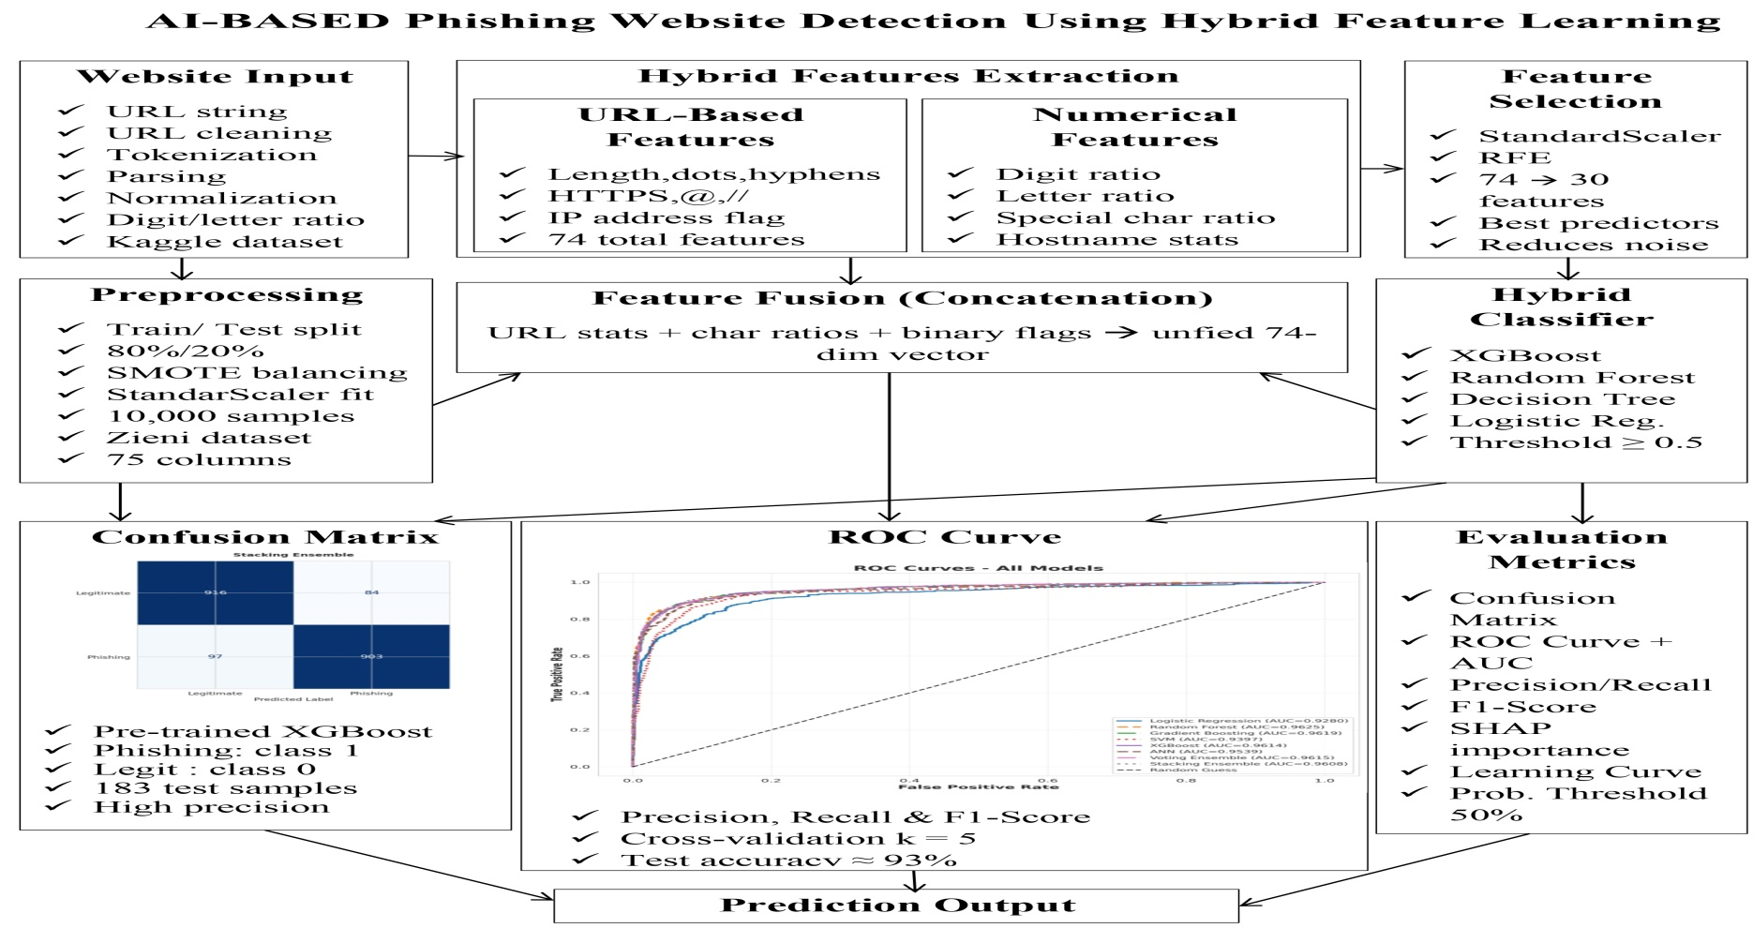
Proposed Solution & Architecture cont.
Fig. 2: Schematic Model Diagram of the Proposed Model
19

Slide 20
Key Components/ Modules & Algorithms Used
ML Models
Logistic Regression – Baseline classifier.
Random Forest – 200-tree ensemble model.
Gradient Boosting – Boosted decision trees.
SVM – RBF kernel classifier.
XGBoost – Optimized boosting model.
Deep Learning & Ensemble
ANN – 4-layer deep neural network.
Soft Voting – RF + XGBoost + SVM combination.
Stacking Ensemble – RF, XGBoost, SVM with Logistic Regression meta-learner.
20

Slide 21
Dataset & Tools/Technologies
DataSet Description :
Dataset : Multi Dataset Phishing.
Source : https://www.kaggle.com/datasets/yasserhessein/multi-dataset-phishing
Types : Multi-dataset aggregated phishing URLs/Websites.
Classes :
Phishing (1)
Legitimate (0)
Features Used :
URL-based features (length,symbols).
Structural features & Token-based features.
Training Data Used : 10,000 samples.
Data Type : CSV/XLSX.
21

Slide 22
Dataset & Tools/Technologies
Tools/Technologies :
Language : Python3(Google Colab).
Frameworks : NumPy, Pandas, Scikit-learn, XGBoost, TensorFlow/keras, SHAP, Matplotlib,Seaborn,imbalanced-learn(SMOTE),joblib.
Hardware :
Intel i5/i7 or equivalent processor .
8 GB RAM (minimum) - 16 GB recommended .
100 GB free storage (SSD preferred) .
22

Slide 23
Experimentation
System Specification :
Parameter | Specification
Platform | Google Colab(cloud-based Jupyter Environment)
Runtime Type | Python 3(CPU/ GPU depending on session)
Primary Language | Python 3.x
OS | Linux(Ubuntu-based,Google Colab backend)
Storage | https://colab.research.google.com/drive/1cV6lnKY8hk_8rSm_HM0U62n5LXsLXGV4?usp=sharing
23

Slide 24
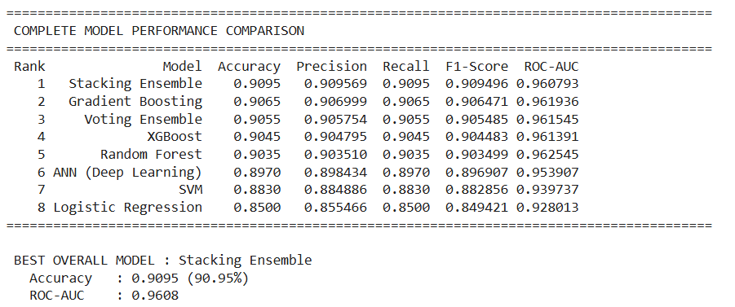
Experimentation
Experimental Results :
Fig. 3 : Result of All Model
24

Slide 25
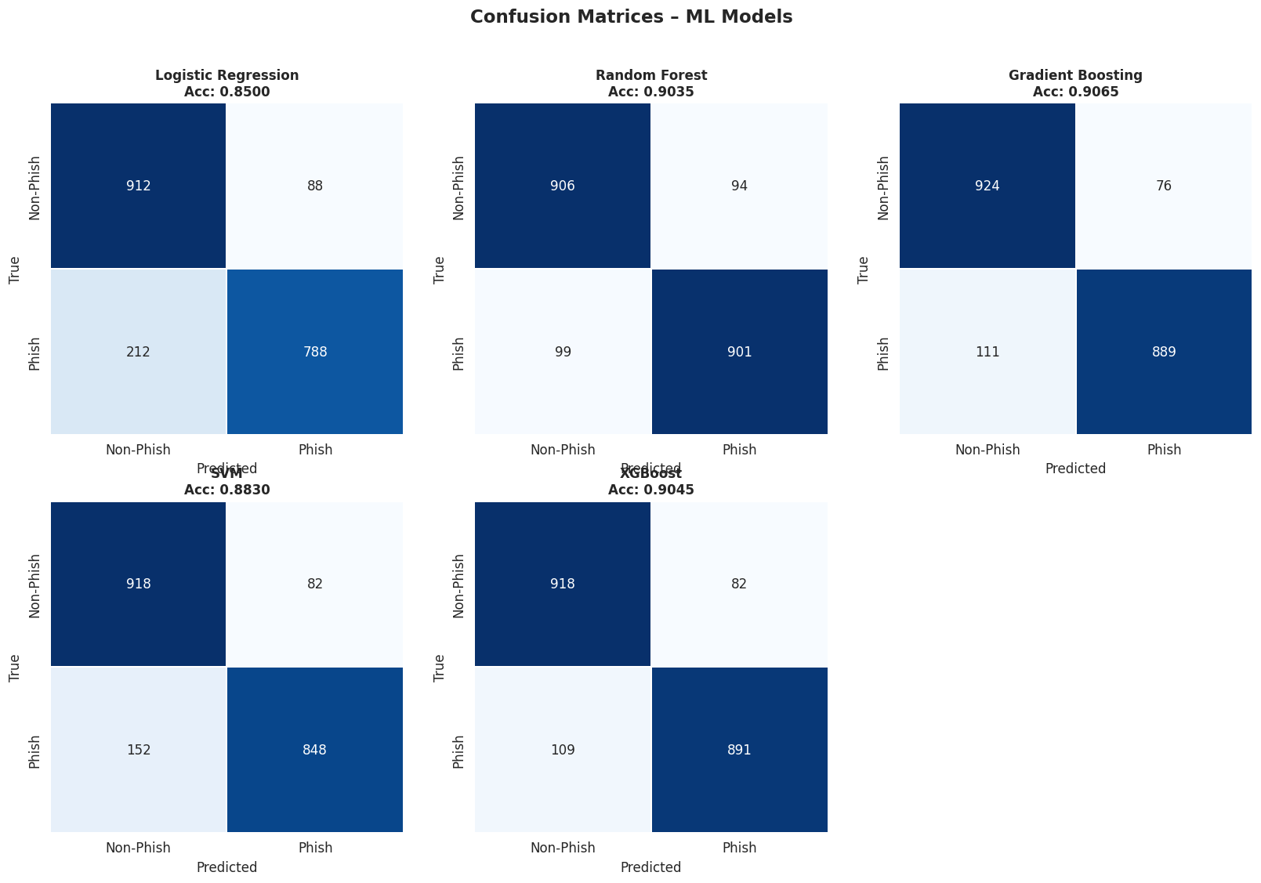
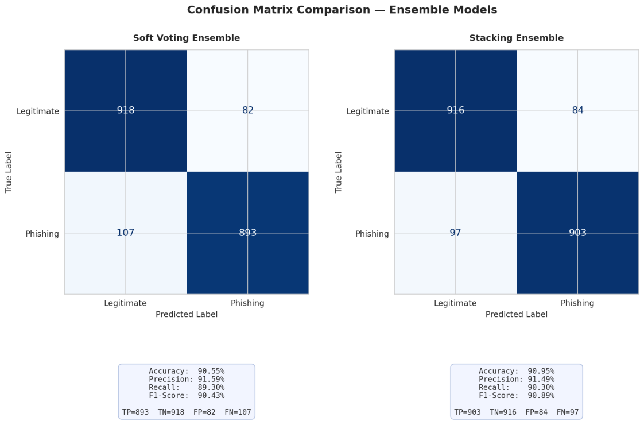
Experimentation
Experimental Results(Confusion Matrix) :
Fig. 4 : Confusion Matrix of All Model
25

Slide 26
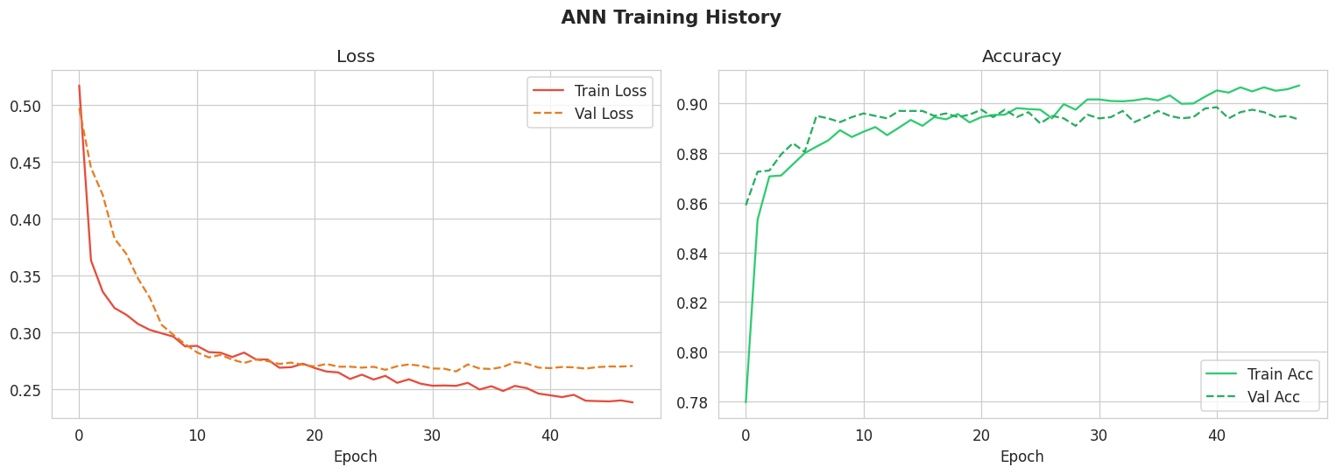
Experimentation
Experimental Results(ANN Training Curves) :
Fig. 5 : ANN Training Curves of All Model
26

Slide 27
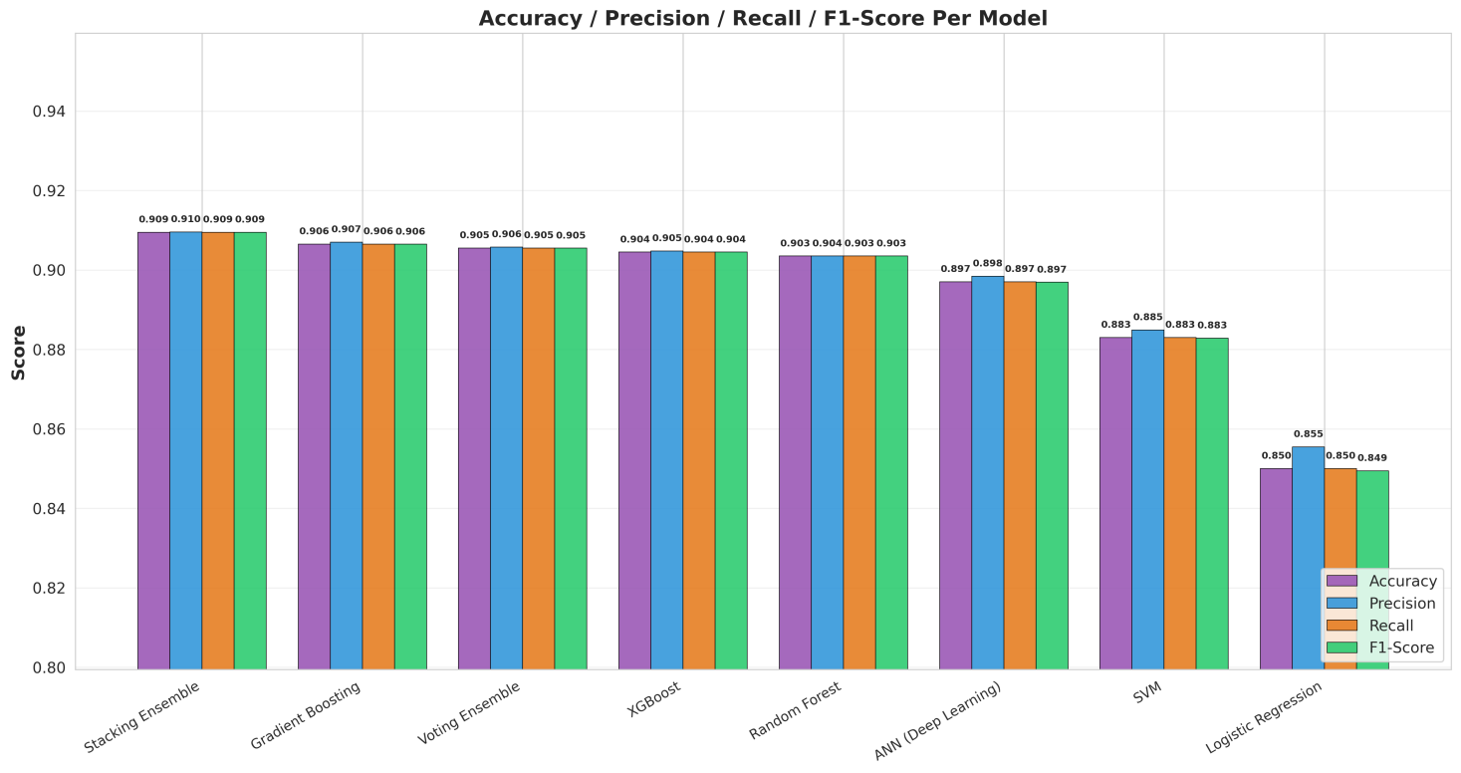
Experimentation
Experimental Results(Metrics comparison) :
Fig. 6 : Metrics comparison of All Model
27

Slide 28
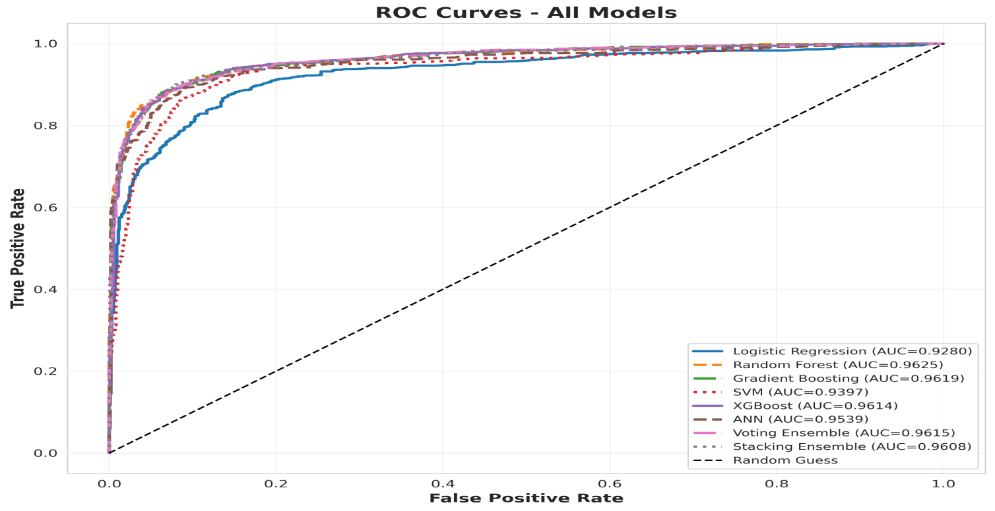
Experimentation
Experimental Results(ROC Curves) :
Fig. 7 : ROC Curves of All Model
28

Slide 29
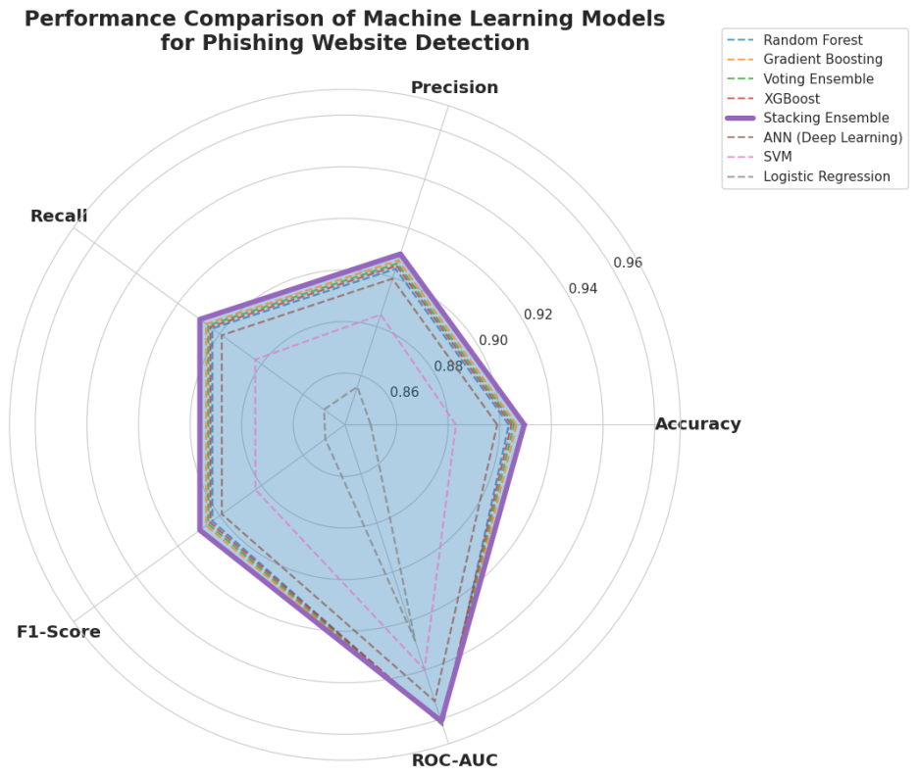
Experimentation
Experimental Results(Radar chart ) :
Fig. 8: Radar Chart of All Model
29

Slide 30
Experimentation
Performance Analysis :
Stacking Ensemble achieved the best overall performance, outperforming all individual ML and DL models in Accuracy and F1-Score.
Logistic Regression showed the weakest results because phishing URL detection involves complex non-linear patterns that linear models cannot effectively capture.
SVM performed well with the RBF kernel, but the Stacking model further improved its performance by combining it with stronger learners through a meta-learner.
30

Slide 31
Experimentation
Performance Analysis :
ANN achieved competitive results, but Stacking still performed better, confirming that ensemble tree-based methods are more effective for structured/tabular phishing datasets.
Random Forest and XGBoost were the strongest individual models, contributing significantly as base learners in the Stacking Ensemble.
Stacking outperformed Soft Voting Ensemble because it learns optimal model combinations using a Logistic Regression meta-learner instead of simple probability averaging.
31

Slide 32
Conclusion and Future Scope
Conclusion :
The Stacking Ensemble model achieved the best overall performance with 90.95% Accuracy and 96.08% ROC-AUC, outperforming all other models.
The project successfully combined preprocessing, SMOTE balancing, feature scaling, and RFE feature selection to build a robust and generalizable phishing detection system.
A phishing URL prediction module was developed, capable of classifying URLs as Phishing or Legitimate, making it suitable for practical cybersecurity applications.
32

Slide 33
Conclusion and Future Scope
Future Scope :
Real-Time Browser Extension :
Integrate the phishing detection model into Chrome/Firefox extensions for instant URL safety warnings.
Enhanced Dataset Collection :
Train the model using larger and diverse real-world phishing datasets from platforms like PhishTank and OpenPhish.
Continuous Model Updating :
Implement periodic retraining mechanisms to adapt to evolving phishing techniques and zero-day attacks.
33

Slide 34
Conclusion and Future Scope
Future Scope :
Website Content Analysis :
Incorporate HTML structure and webpage similarity analysis for improved phishing detection accuracy.
Cloud-Based Deployment :
Deploy the model as a scalable cloud-based cybersecurity service for enterprise-level protection.
Multi-Class Threat Classification :
Extend binary classification to identify multiple cyber threats such as phishing, spam, malicious redirects, and fake login pages.
34

Slide 35
References
[1] | N. Tabassum, F. F. Neha, M. S. Hossain, and H. S. Narman,“A hybrid machine learning-based phishing website detection technique through dimensionality reduction,”in Proc. IEEE Int. Black Sea Conf. Commun. Netw. (BlackSeaCom), 2021.
[2] | S. D. Gupta, K. T. Shahriar, H. Alqahtani, D. Alsalman, and I. H. Sarker,“Modeling hybrid feature-based phishing websites detection using machine learning techniques,”Annals of Data Science, 2022.
[3] | M. M. Raj and J. A. A. Jothi,“Hybrid approach for phishing website detection using classification algorithms,”PARADIGM Plus, vol. 3, no. 3, pp. 16–29, 2022.
[4] | R. Pal, M. K. Pandey, S. Pal, and D. C. Yadav,“Phishing detection: A hybrid model with feature selection and machine learning techniques,”Int. J. Exp. Res. Rev., vol. 36, pp. 99–108, 2023.
[5] | S. Kavya and D. Sumathi,“Design of a hybrid AI-based phishing website detection using LSTM, CNN, and random forest-based ensemble learning analysis,”in Proc. 8th Int. Conf. Electron., Commun. Aerosp. Technol. (ICECA), 2024.
[6] | K. Rangaswamy, S. Khaleel, N. Pradeep, K. S. S. R. Krishna, and J. V. Charan,“Phishing website detection using machine learning and deep learning techniques,”Power System Technology, 2025.

Slide 36
References
[7] | K. P. Sankar and P. B. Naidu,“URL-based phishing detection using a hybrid machine learning model,”Industrial Engineering Journal, vol. 54, no. 5, May 2025.
[8] | A. Jadhav and P. Chandre,“A hybrid heuristic-machine learning framework for phishing detection using multi-domain feature analysis,”Engineering, Technology & Applied Science Research, vol. 15, no. 5, pp. 27219–27226, Oct. 2025.
[9] | S. S. Wakchaure, J. S. Kale, S. R. Dange, and G. S. Wakchaure,“Phishing website detection using hybrid machine learning and feature optimization techniques,”Industrial Engineering Journal, vol. 54, no. 11, Nov. 2025.
[10] | R. Ghadami and J. Rahebi,“An explainable hybrid deep learning-optimization framework for robust phishing attack detection using GAN and transformer-based feature learning,”Ain Shams Engineering Journal, vol. 16, Art. no. 103745, Dec. 2025.
[11] | P. Ahirwar and A. Shrivastava, "Phishing website detection: A systematic review of URL-based and deep learning approaches," International Journal of Innovations in Science Engineering and Management, vol. 5, no. 2, pp. 29–37, Apr. 2026.
[12] | A. Sravanthi, A. A. Kousar, A. R. Dabole, G. J. G, and S. Elango, "Hybrid AI for phishing site detection," International Research Journal of Modernization in Engineering Technology and Science, vol. 8, no. 4, pp. 10446–10453, Apr. 2026.

Slide 37

37

